Slide 1

Hotel Management System : For Staff
Team Members:
Navyaprabha Rajappa
Pradeep Kumar

Slide 2
Agenda
Introduction to Hotel Management System
Features of Hotel Management Systems
Benefits of Hotel Management Systems
Challenges of Implementing Hotel Management Systems
Future Work
Conclusion

Slide 3
Introduction to Hotel Management System
Hotel management system refers to the software that is used by hotels and other hospitality businesses to manage their operations. This includes managing reservations, room assignments, guest information, billing, and Staff management.
The use of hotel management systems has become increasingly popular in recent years due to the benefits they offer, such as increased efficiency, improved guest experience, and better data management.

Slide 4

Motivation
The motivation behind developing a hotel management system for hotel staff is to provide an efficient and streamlined process for managing hotel operations. The system is designed to help staff in managing various hotel operations such as room booking, guest check-in and check-out, staff management, complaint management, and overall hotel performance analysis in a centralized location.
The system also provides real-time information on room availability, occupancy rates, and earnings, which can help hotel management make informed decisions. By implementing this system, hotels can improve their overall efficiency, reduce the risk of errors, and provide a better guest experience.

Slide 5

Goals
The system aims to simplify the hotel management process, increase staff productivity, and improve the customer experience by providing a streamlined and user-friendly interface for managing hotel operations.
To provide staff with a tool that can help them manage their workload and improve productivity. The goal is to create a system that is easy to use, reduces manual effort, and provides real-time data and insights to help make informed decisions to improve the hotel's overall performance.
Improving financial management by providing real-time data on room occupancy, earnings, and expenses.
To reduce errors and inaccuracies in the booking and billing process by automating these functions.

Slide 6

Scope
The scope of this Hotel Management System is to provide a user-friendly interface for the staff of a hotel to manage and monitor the hotel's operations. It includes features such as user authentication, reservation management, guest management, room management, staff management, complaint management, statistics, search bar, and logout.

Slide 7
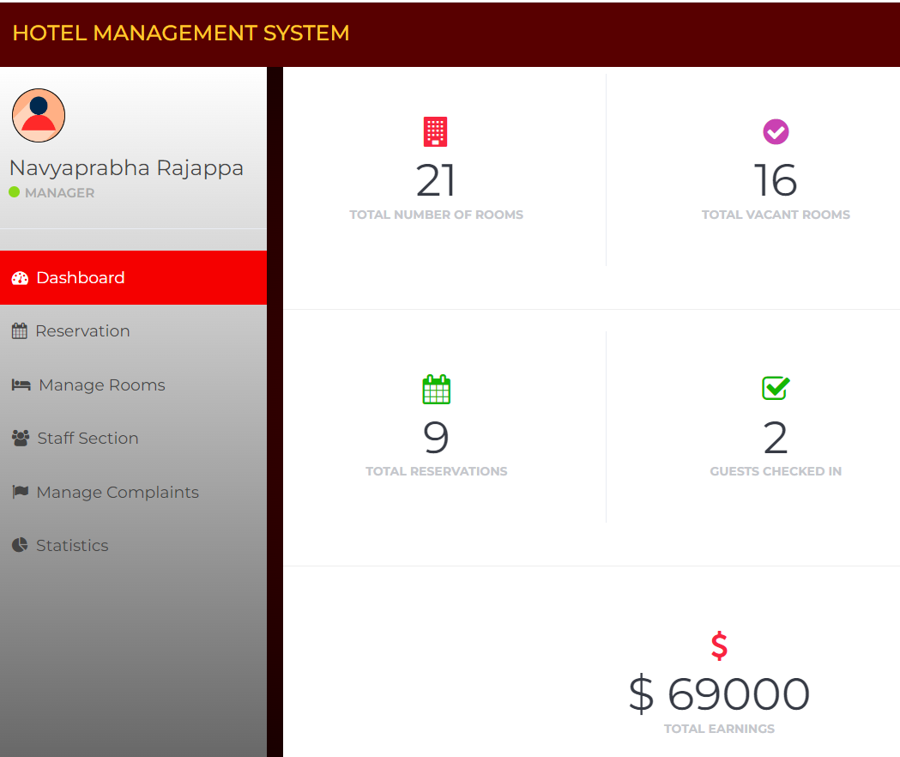
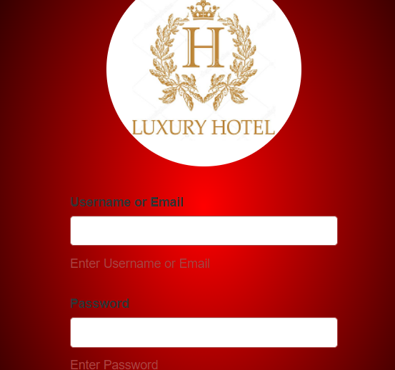
Features of Hotel Management Systems
Hotel management systems come with a range of features that help hotels manage their operations more effectively.
Sign in- Allows staff to login only after they enter username and password. This way we can authenticate staff.
Dashboard-As soon as staff login they can see all the information listed below:
Total number of rooms, vacant rooms, booked rooms, total reservations, guests checked in, total staff, total pending payments, total earnings, total complaints.

Slide 8
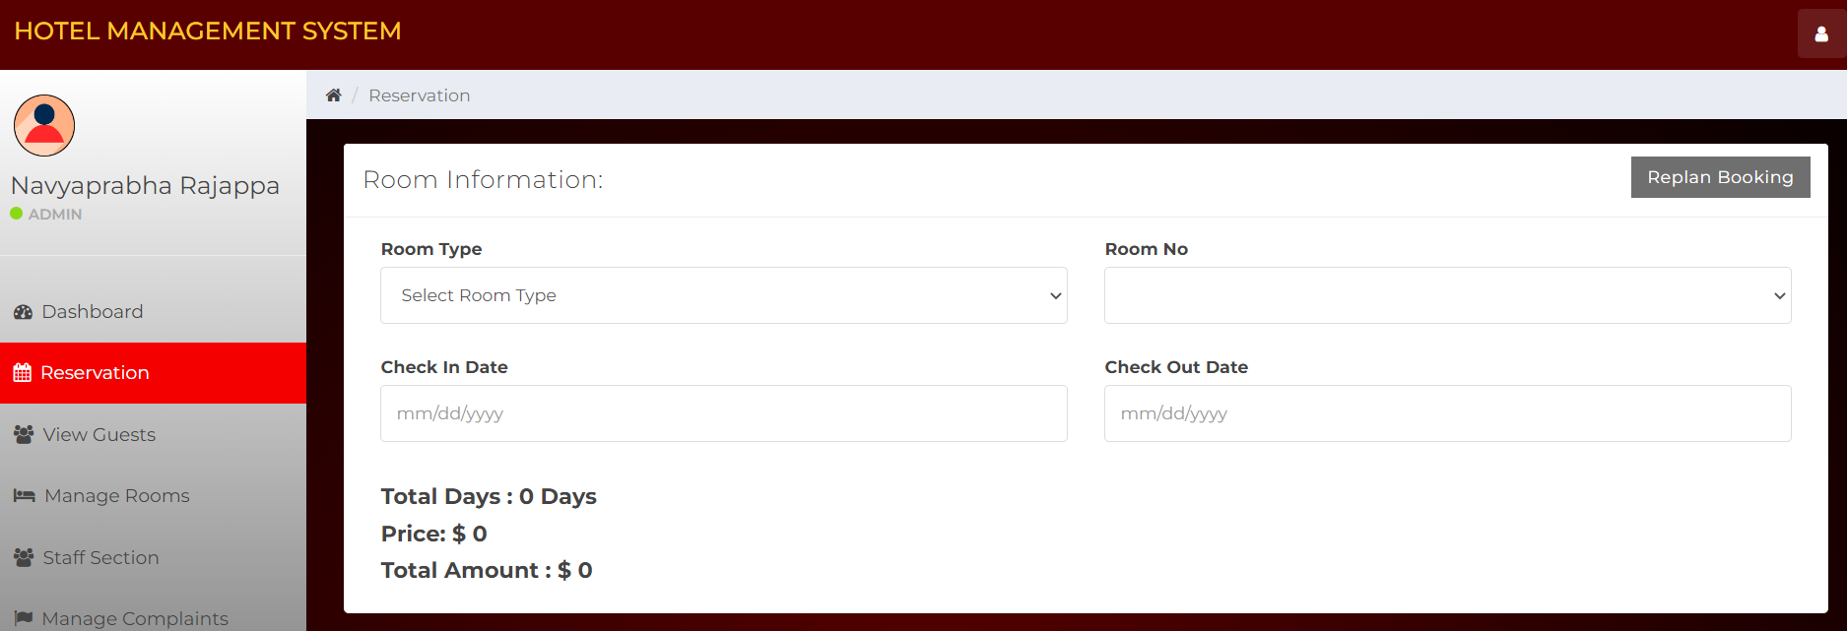
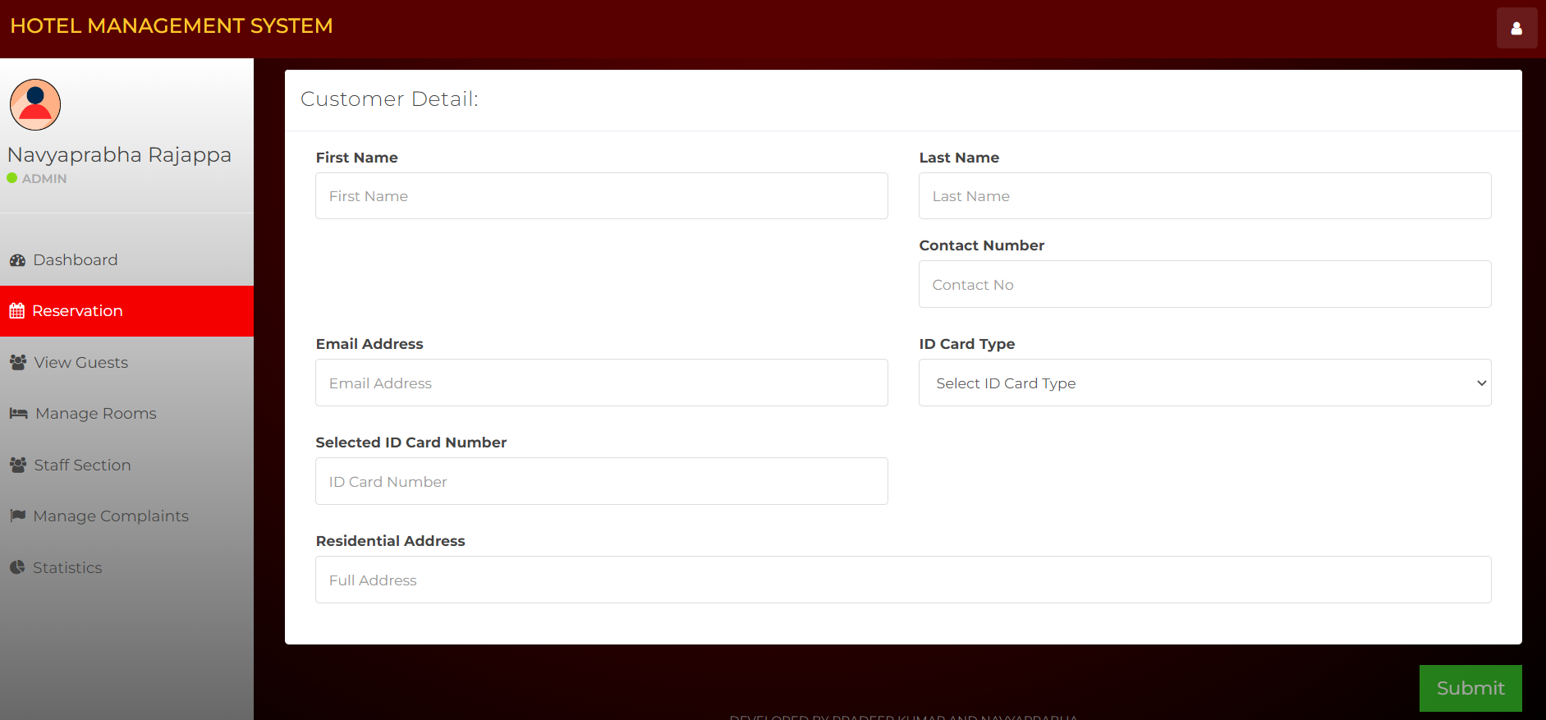
Features of Hotel Management Systems
Reservation- Allows staff to book room for customers.
Here they can enter Room type, room number, check-in and check-out dates.
They can even Replan-Booking according to customers needs.
Also, customer details like Name, contact, email, ID, Address.
A button to submit all the information entered.

Slide 9
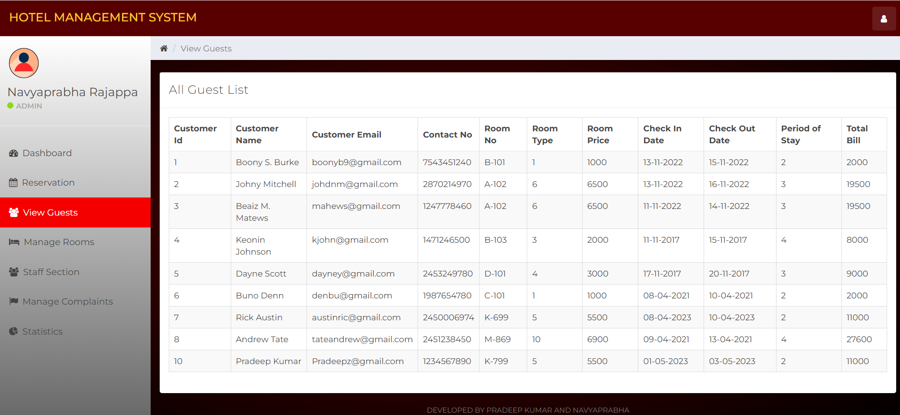
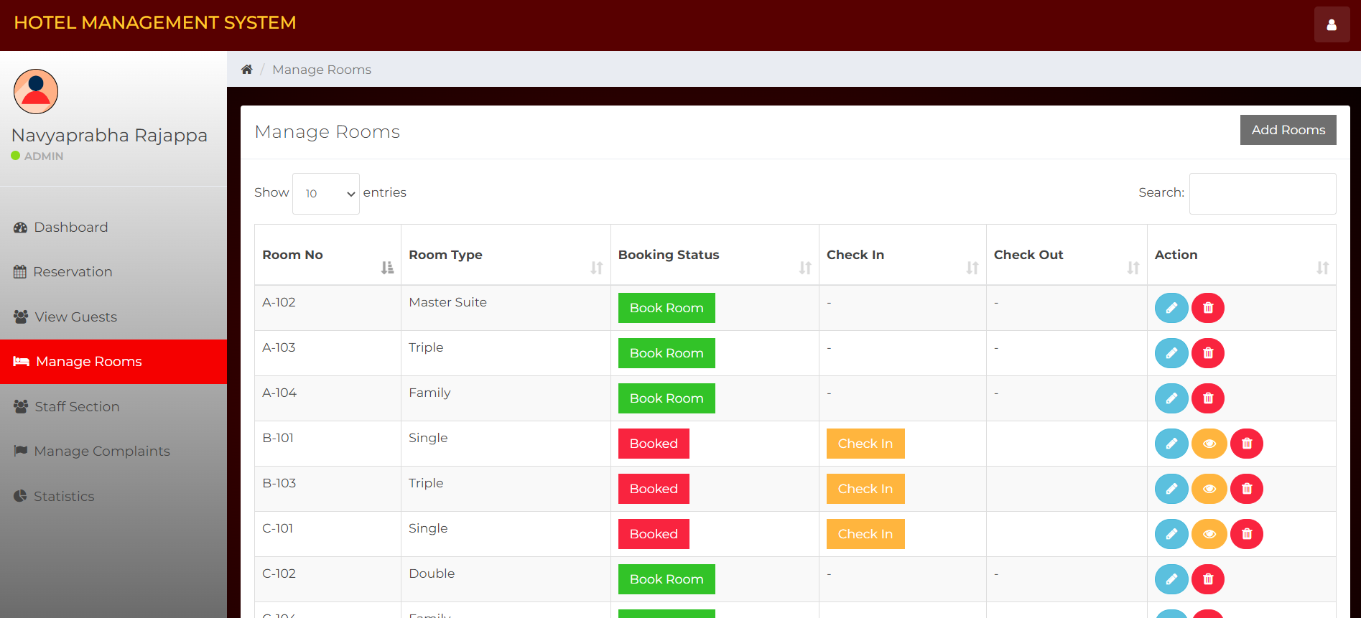
Features of Hotel Management Systems
View Guests- This option allows staff to see all the information about their customers like customer name, email id , contact number, room number, room type, room price, check-in, check-out , period of stay, total bill.
Manage Rooms- Allows users to manage rooms, where they can see if room is booked or not. Also, can find if room is checked-in and customer can checkout after making the payment.
They can view the details of customer and Edit details of room and delete the record too
Additionally, it allow hotel management to add new room when they require.
There is a search bar which allows user to quickly search the room numbers.

Slide 10
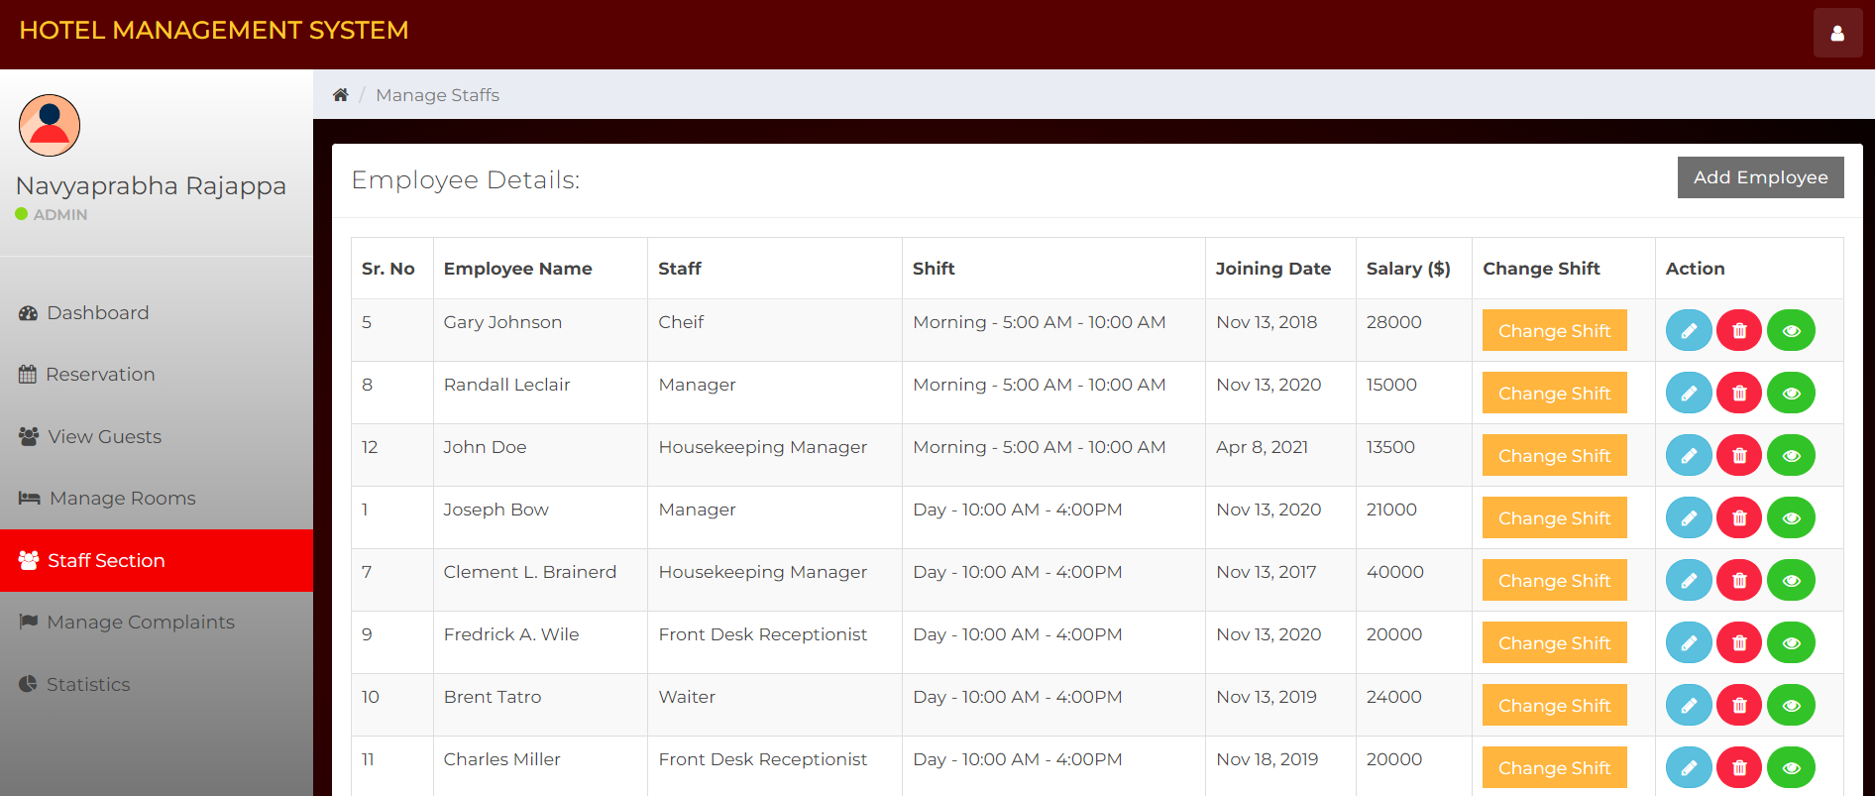
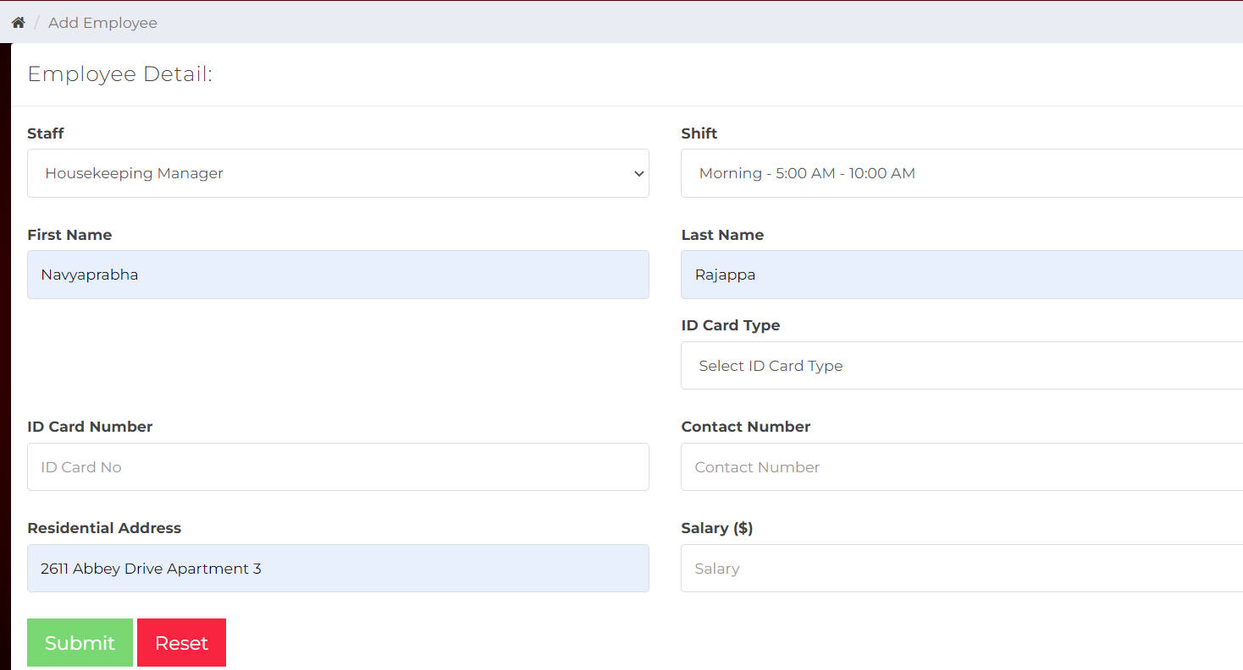
Features of Hotel Management Systems
Staff Section- Allows users to manage staff, where they can see complete details about staff like Name, position, shift they work, joining date, salary. They can view the details of Employee(employee history), delete the employee record and Edit details of Employee.
They can change the employee shift if needed.
Additionally, it allow hotel management to add new Employee when they join.
There is a search bar which allows user to quickly search the Employee details.

Slide 11
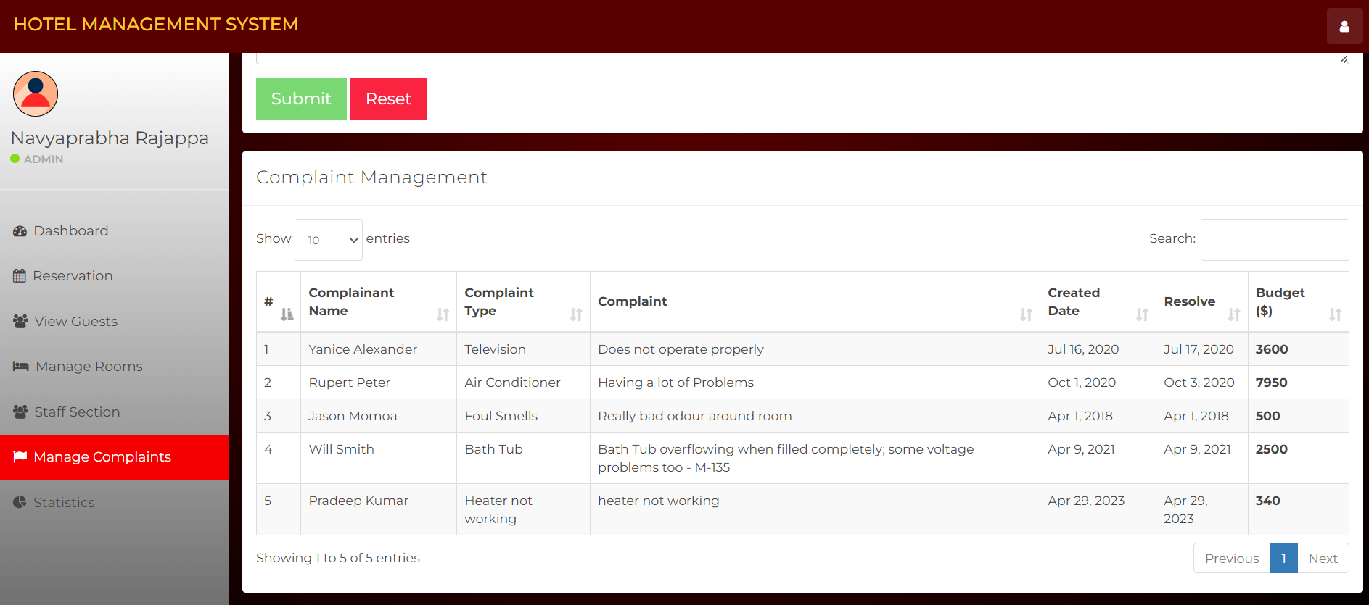
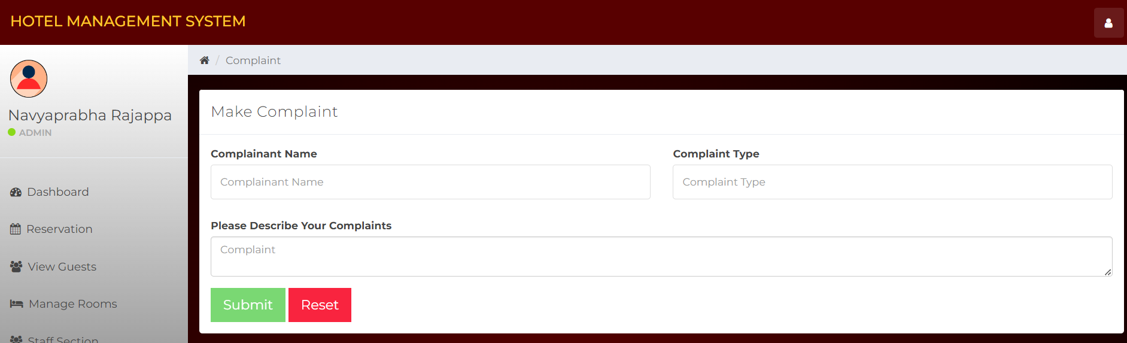
Features of Hotel Management Systems
Manage Complaints- Allows users to manage Complaints, where they can see complete details about complaint, who filed the complaint, complaint type, description, created date, resolved type, Budget for it.
Make Complaint- They can take note of complaints from customers along with there name description and complaint type.
There is a search bar which allows user to quickly search the Complaint details.

Slide 12
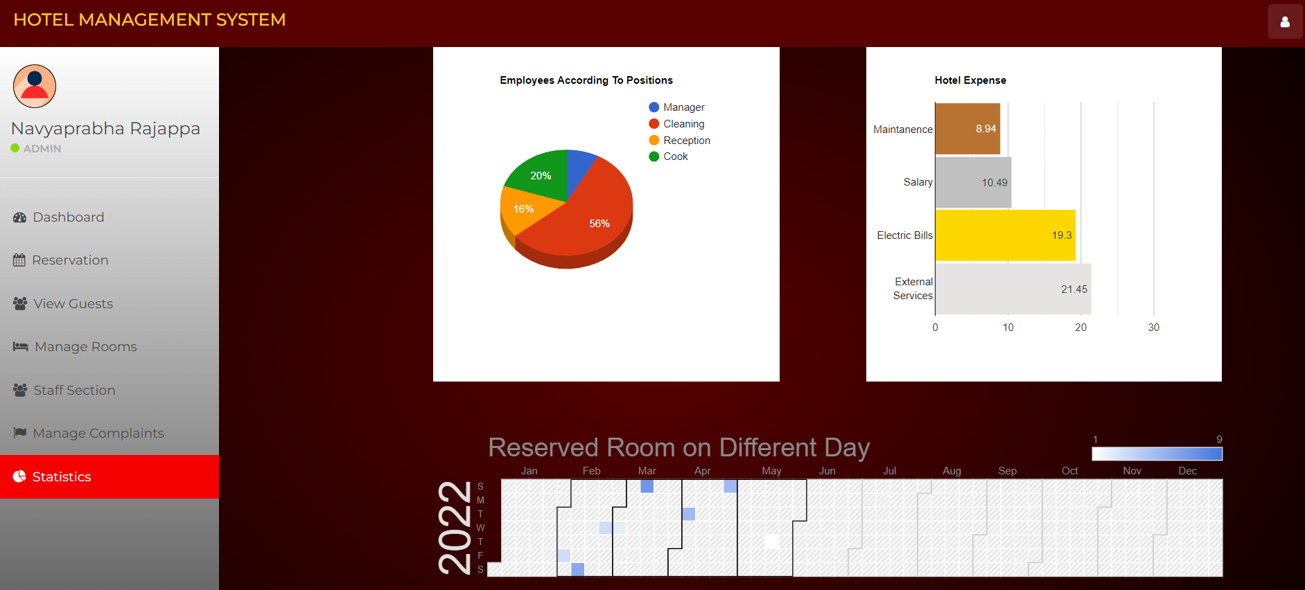
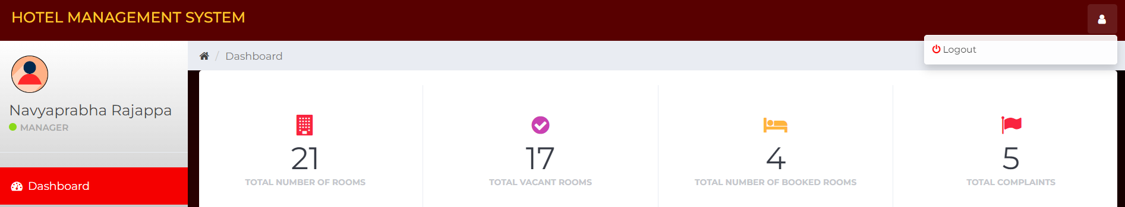
Features of Hotel Management Systems
Statistics- In this page you can see overall statistics about Reserved rooms on different days throughout the year, hotel expenses on maintenance, electrical bills, salary and external services, Employees according to position like Manager, cleaning, reception and cook(Total employees in each section).
Logout: Allows users to logout safely.

Slide 13
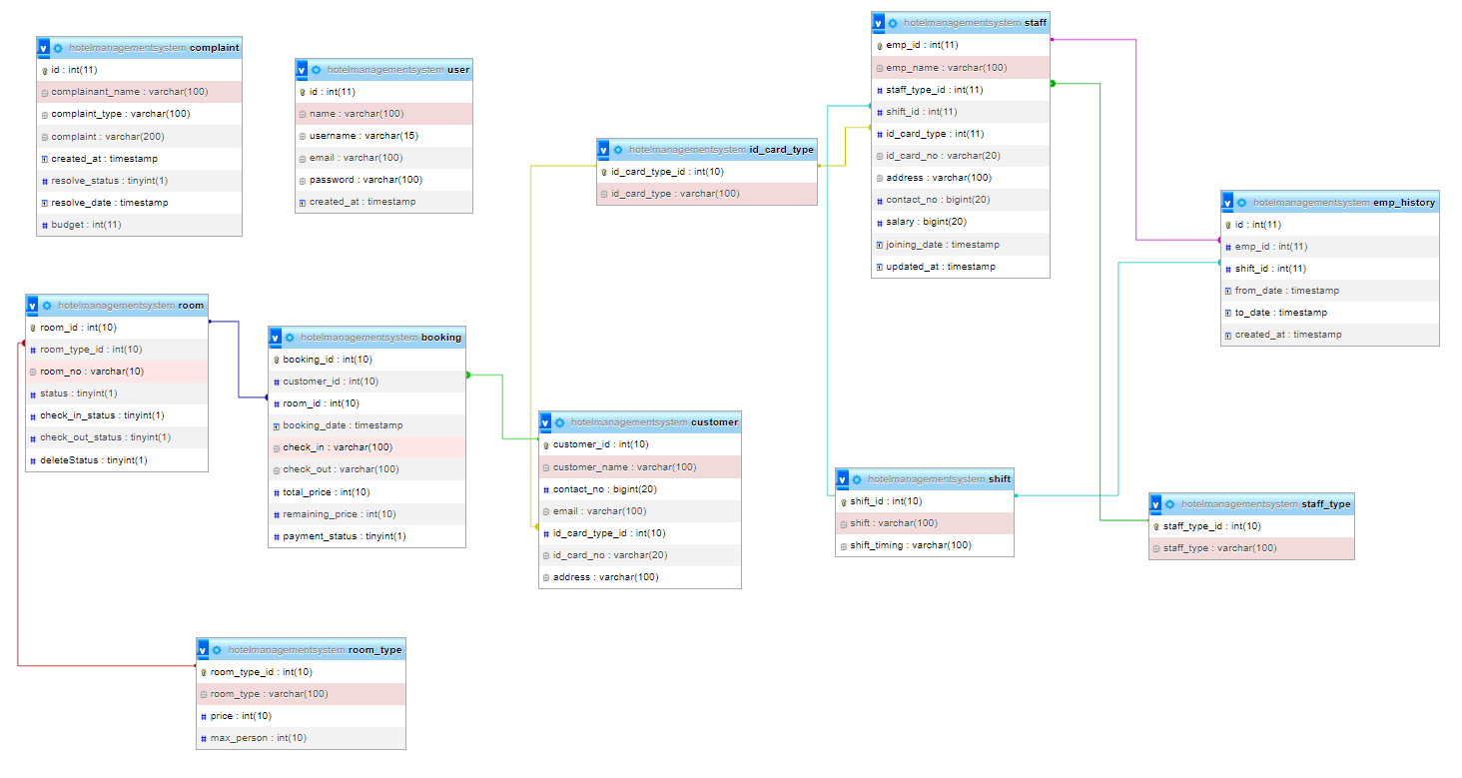
Relational Schema

Slide 14
Technology stack
XAMPP Control Panel v3.3.0 - XAMPP Control Panel v3.3.0 is a software application that allows users to easily manage and control the XAMPP server, which is a popular open-source software stack for web development
Apache - Apache is an open-source web server software that is widely used to serve web pages over the internet.
MySQL - MySQL is an open-source relational database management system that uses SQL (Structured Query Language) to manage and organize data.
PHP - PHP is a popular open-source server-side scripting language that is used to create dynamic web pages and web applications.
JavaScript - JavaScript is a popular programming language used for creating interactive and dynamic web pages and web applications. It runs on the client-side, meaning it is executed by a user's web browser rather than a server
CSS - CSS (Cascading Style Sheets) is a stylesheet language used to describe the presentation and styling of HTML or XML documents, including colors, layouts, fonts, and other design aspects.
SQL - SQL (Structured Query Language) is a standard programming language used to manage and manipulate relational databases. It is used for tasks such as creating, updating, and querying databases, as well as managing access control and user permissions.
Font Awesome library – Font Awesome is a popular open-source icon library that provides scalable vector icons that can be customized using CSS. It includes a wide range of icons, such as social media icons, UI icons, and various other icons for web development.

Slide 15
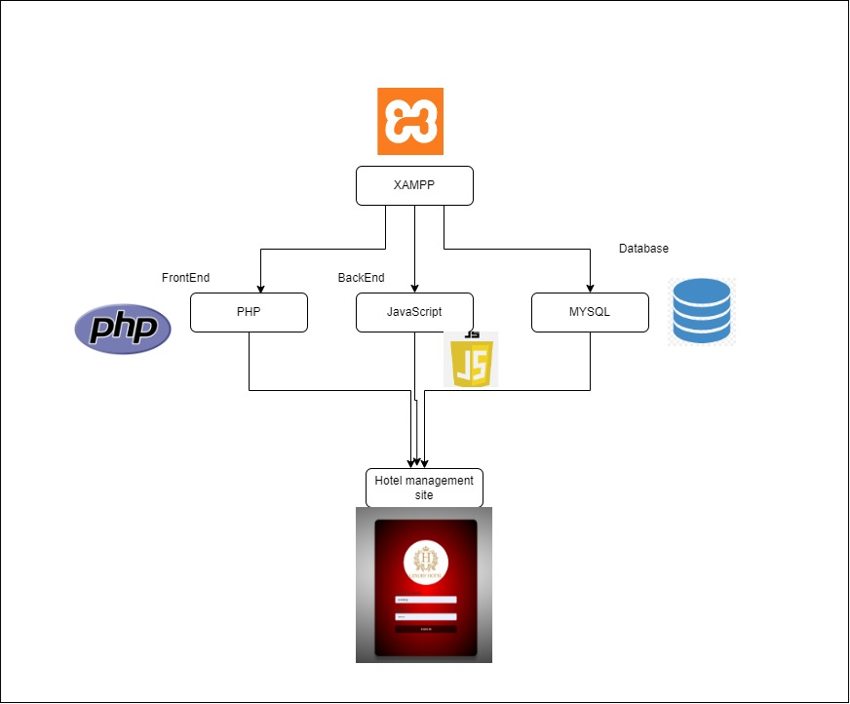
System Architecture

Slide 16

LIVE DEMO

Slide 17

Benefits of Hotel Management Systems
The use of hotel management systems offers several benefits to hotels and their guests. One major benefit is increased efficiency, as these systems automate many tasks that were previously done manually, such as room assignments and billing.
Hotel can manage their employees and there records more effectively. Also, there is no hustle of maintaining manual books

Slide 18
Challenges of Implementing Hotel Management Systems
While hotel management systems offer many benefits, there are also challenges associated with implementing these systems. One challenge is the cost, as these systems can be expensive to purchase and implement, especially for smaller hotels.
Another challenge is the learning curve associated with using these systems, as staff members may need to be trained on how to use new software and processes. Finally, there may be resistance from staff members who are used to doing things manually and are resistant to change.

Slide 19
Future Work
Can implement much more features like Landry, food and other amenities services booking section for guests. Also build software for users to book rooms on there own.
Additionally, in future we may add the capability of allowing guests to make online reservations for the hotel, which will allow better experience for guests.

Slide 20
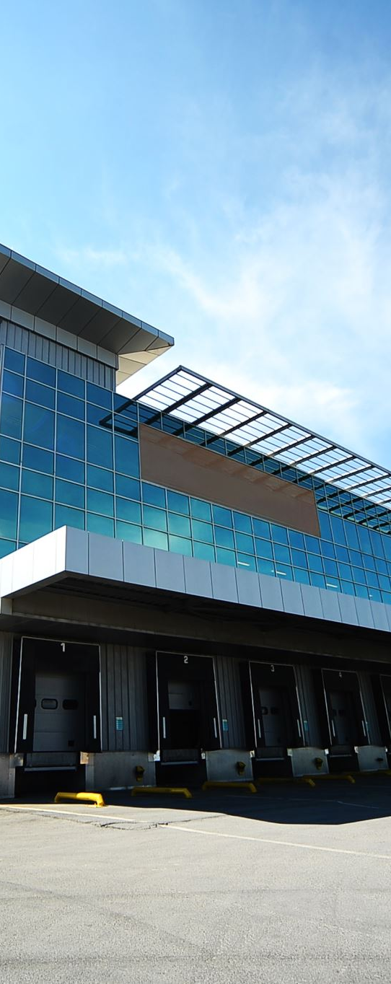
Conclusion
In conclusion, hotel management systems offer a range of benefits to hotels and their guests, including increased efficiency, improved guest experience, and better data management. While there are challenges associated with implementing these systems, the future looks bright for this technology as it continues to evolve and improve.
As hotels continue to invest in these systems, we can expect to see even more innovation and integration with other technologies, ultimately leading to a better overall experience for guests and greater profitability for hotel owners.

Slide 21

Thank you
Any Questions?

